Slide 1

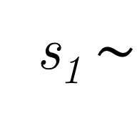
1
State
s₁$∼$
+
0
1
1
1 sec
Action
+
s₁
1‒s₁
1‒s₁
s₁
Time
0
1 sec
Reward
0
1
0
1

